Slide 1
“Exemplary” Finding CAR CAR Number: 123911379
By Adele Fan

Slide 2
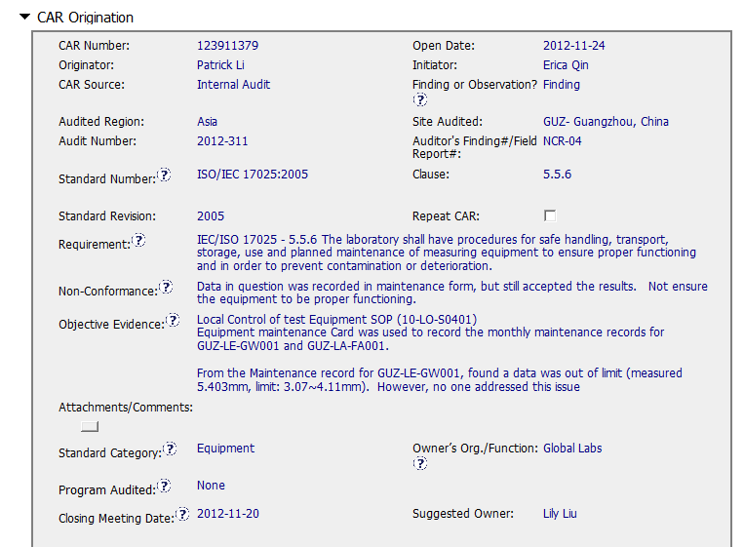
“Exemplary” Finding CAR CAR Number: 123911379
Non-conformance is described clearly against specific standard requirement with supporting evidence

Slide 3
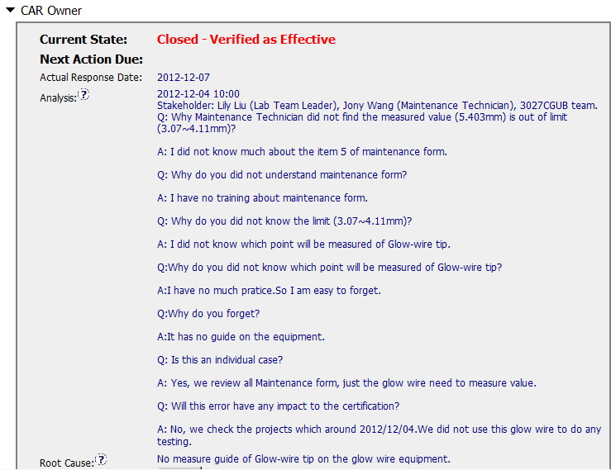
“Exemplary” Finding CAR CAR Number: 123911379
“five whys” approach leading to the root cause of the nonconformance and how widespread the problem is
Stakeholders are identified
The root cause is succinct,
• reasonable and complete based upon the analysis

Slide 4
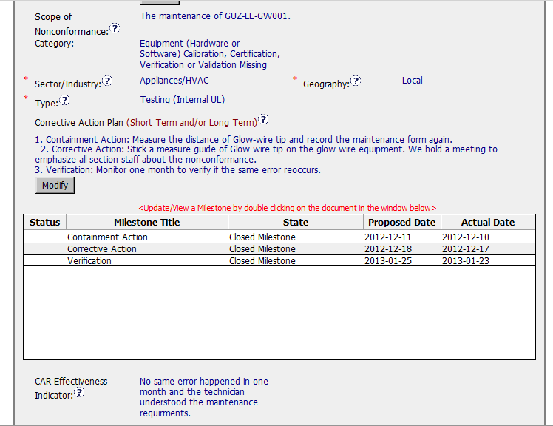
“Exemplary” Finding CAR CAR Number: 123911379
Category and Type is appropriate
Geography is apparent from the analysis
Corrective Actions fix the objective evidence, address the entire root cause and the items identified in the analysis and cover the scope and geography
Milestone address containment and have final milestone for owner’s verification of effectiveness completed per milestone expectations
Verification is completed (4-9-2013) within 6 months of CAR closure (1-23-2013)

Slide 5
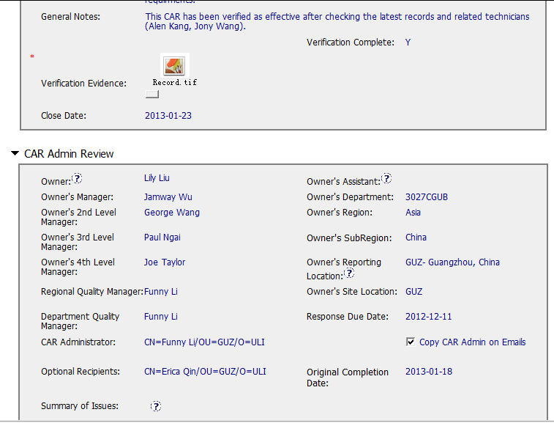
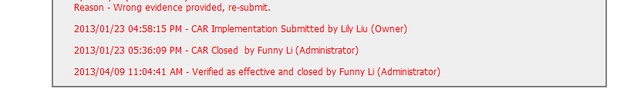
“Exemplary” Finding CAR CAR Number: 123911379
Verification is completed (4-9-2013) within 6 months of CAR closure (1-23-2013)

